Slide 1
Deep Learning
Lecture 2

Slide 2
Bias in Deep Learning
Bias is an additional parameter in a neural network that lets the model adjust its output independently of the input.
This is equivalent to the intercept in a linear equation y=mx+b
It allows the activation function to shift horizontally.
It enables the network to better fit the data—even when all input features are zero.

Slide 3
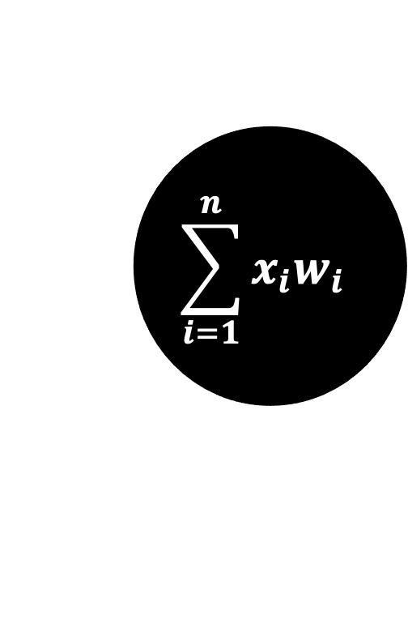
Role of Bias
1
$$\sum_{i=1}^{n}{x_{i}w_{i}}$$
-0.55
F
2
0.1

Slide 4
Why Bias

Slide 5
Weights Initialization in Deep Learning
Zero Initialization
Random Initialization
Xavier (Glorot) Initialization
He Initialization

Slide 6
Zero Initialization
Setting all weights to zero causes all neurons to learn the same features, making them redundant
This prevents the network from learning properly.

Slide 7
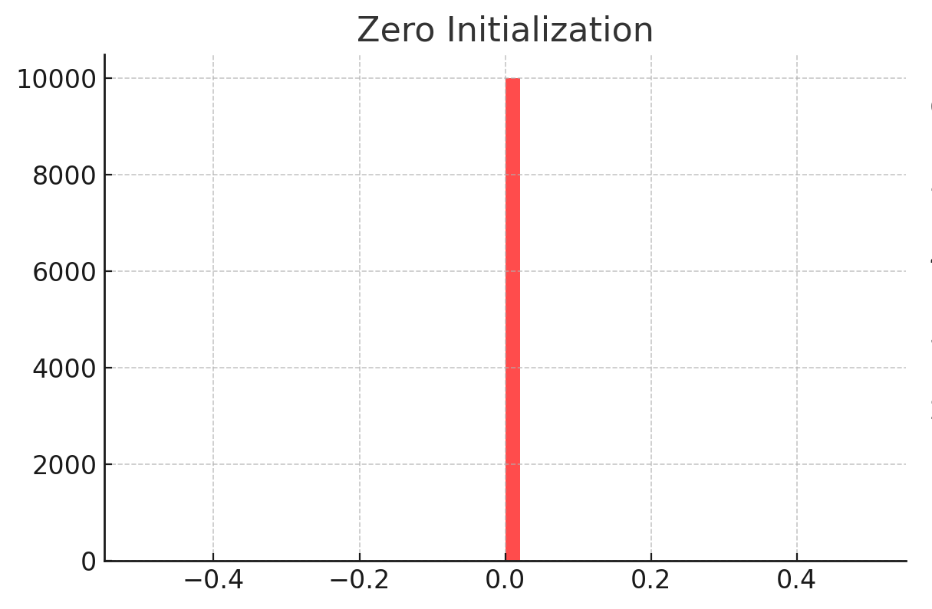
Zero Initialization

Slide 8
Random Initialization
Small random values (e.g., Gaussian or Uniform distribution) are assigned to break symmetry.
Weights are assigned from a uniform distribution between a range, typically:
W = np.random.uniform(-0.1, 0.1, size=(layer_size, prev_layer_size))

Slide 9
Random Initialization
A Simple 3-Layer Neural Network
Assume we have a network with:
Input layer (5 neurons)
Hidden layer (4 neurons)
Output layer (3 neurons)

Slide 10
Random Initialization
We initialize weights for:
Hidden Layer: Weights connect 5 input neurons to 4 hidden neurons → Shape (4, 5)
Output Layer: Weights connect 4 hidden neurons to 3 output neurons → Shape (3, 4)

Slide 11
Random Initialization
Weight Matrix Shape: (4, 5)
[[ 0.01 -0.02 0.005 0.01 -0.01 ]
[-0.005 0.03 -0.02 0.02 -0.01 ]
[ 0.01 -0.01 0.02 -0.005 0.01 ]
[-0.02 0.015 -0.01 0.03 -0.02 ]]

Slide 12
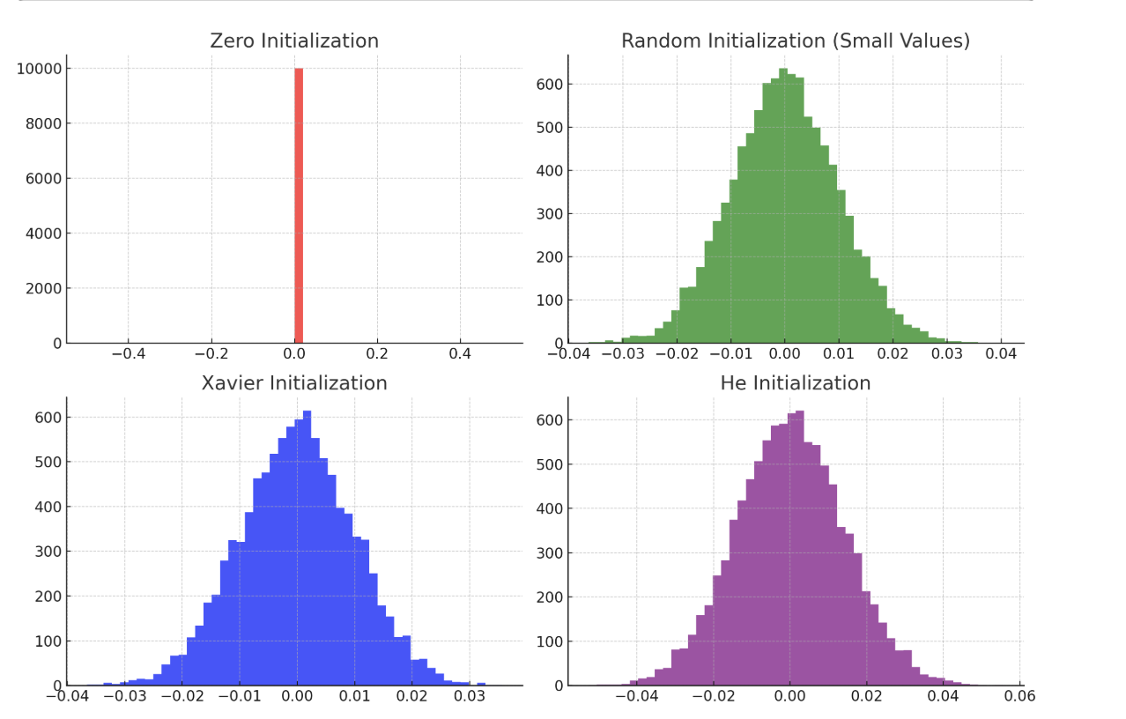
Random Initialization

Slide 13
Xavier (Glorot) Initialization
Used for sigmoid and tanh activation functions.
Weights are drawn from a normal or uniform distribution with variance controlled by the number of inputs and outputs.
Low variance → Small weights → Vanishing gradients (slow learning).
High variance → Large weights → Exploding gradients (unstable learning).
Techniques like Xavier and He initialization set variance based on the number of neurons in the layer to ensure stable learning.
W = np.random.randn(n_out, n_in) * np.sqrt(2 / (n_in + n_out))

Slide 14
Xavier (Glorot) Initialization

Slide 15
He Initialization
Used for ReLU and Leaky ReLU activation functions.
Helps prevent the vanishing gradient problem.
W = np.random.randn(n_out, n_in) * np.sqrt(2 / n_in)

Slide 16
He Initialization

Slide 17
Leaky Relu
Leaky ReLU is an activation function used in neural networks to solve the dying ReLU problem (when neurons output zero and stop learning).
It introduces a small negative slope for negative inputs instead of setting them to zero.

Slide 18
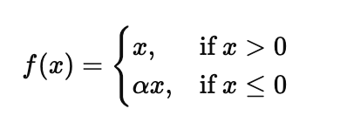
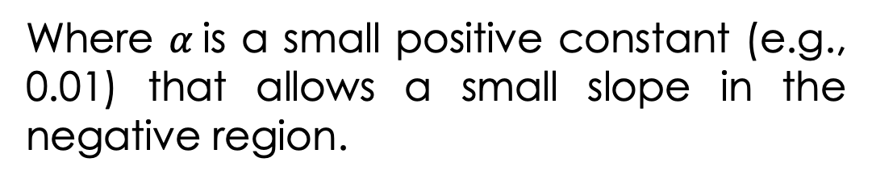
Leaky Relu
Where $α$is a small positive constant (e.g., 0.01) that allows a small slope in the negative region.

Slide 19
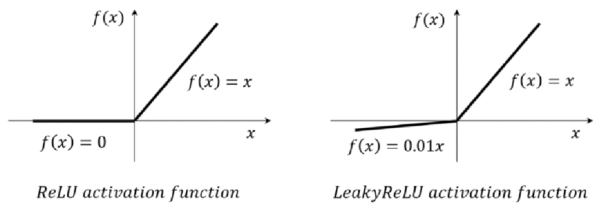
Leaky Relu
https://www.researchgate.net/publication/358306930_cardiGAN_A_Generative_Adversarial_Network_Model_for_Design_and_Discovery_of_Multi_Principal_Element_Alloys/figures?lo=1&utm_source=google&utm_medium=organic

